Slide 1
Data warehouse architecture
Steps for the Design and Construction of Data Warehouses
  The Design of a Data Warehouse: A Business Analysis Framework
  The Process of Data Warehouse Design
Data Mining: Concepts and Techniques

Slide 2
Design of Data Warehouse: A Business Analysis Framework
A data warehouse may provide a competitive advantage by presenting relevant information to help win over competitors.
A data warehouse can enhance business productivity because it is able to quickly and efficiently gather information that accurately describes the organization.
A data warehouse facilitates customer relationship management because it provides a consistent view of customers and items across all lines of business.
Finally, a data warehouse may bring about cost reduction by tracking trends, patterns, and exceptions over long periods in a consistent and reliable
Data Mining: Concepts and Techniques

Slide 3
Design of Data Warehouse: A Business Analysis Framework
Four views regarding the design of a data warehouse
  Top-down view
    allows selection of the relevant information necessary for the data warehouse
  Data source view
    exposes the information being captured, stored, and managed by operational systems
  Data warehouse view
    consists of fact tables and dimension tables
  Business query view
    sees the perspectives of data in the warehouse from the view of end-user
Data Mining: Concepts and Techniques

Slide 4
Data Warehouse Design Process
Top-down, bottom-up approaches or a combination of both
  Top-down: Starts with overall design and planning (mature)
  Bottom-up: Starts with experiments and prototypes (rapid)
From software engineering point of view
  Waterfall: structured and systematic analysis at each step before proceeding to the next
  Spiral: rapid generation of increasingly functional systems, short turn around time, quick turn around
Typical data warehouse design process
  Choose a business process to model, e.g., orders, invoices, etc.
  Choose the grain (atomic level of data) of the business process
  Choose the dimensions that will apply to each fact table record
  Choose the measure that will populate each fact table record
Data Mining: Concepts and Techniques

Slide 5
Contd….
Various kinds of data warehouse design tools are available.
Data warehouse development tools provide functions to define and edit metadata repository contents (such as schemas, scripts, or rules), answer queries, output reports, and ship metadata to and from relational database system catalogues.
Planning and analysis tools study the impact of schema changes and of refresh performance when changing refresh rates or time windows.
Data Mining: Concepts and Techniques

Slide 6
A Three-Tier Data Warehouse Architecture
The bottom tier is a warehouse database server
The middle tier is an OLAP server
The top tier is a front-end client layer
Data Mining: Concepts and Techniques

Slide 7
A Three-Tier Data Warehouse Architecture
The bottom tier is a warehouse database server
  a relational database system.
  Back-end tools and utilities are used to feed data into the bottom tier from operational databases or other external sources
  These tools and utilities perform data extraction, cleaning, and transformation as well as load and refresh functions to update the data warehouse
Data Mining: Concepts and Techniques

Slide 8
A Three-Tier Data Warehouse Architecture
The bottom tier is a warehouse database server
  The data are extracted using application program interfaces known as gateways.
  Examples of gateways include ODBC (Open Database Connection) and OLEDB (Open Linking and Embedding for Databases) by Microsoft and JDBC (Java Database Connection).
  This tier also contains a metadata repository, which stores information about the data warehouse and its contents.
Data Mining: Concepts and Techniques

Slide 9
A Three-Tier Data Warehouse Architecture
2. The middle tier is an OLAP server that is typically implemented using either
a relational OLAP (ROLAP) model, that is, an extended relational DBMS that maps operations on multidimensional data to standard relational operations; or
a multidimensional OLAP (MOLAP) model, that is, a special-purpose server that directly implements multidimensional data and operations
Data Mining: Concepts and Techniques

Slide 10
A Three-Tier Data Warehouse Architecture
3. The top tier is a front-end client layer
contains query and reporting tools, analysis tools, and/or data mining tools (e.g., trend analysis, prediction, and so on).
Data Mining: Concepts and Techniques

Slide 11
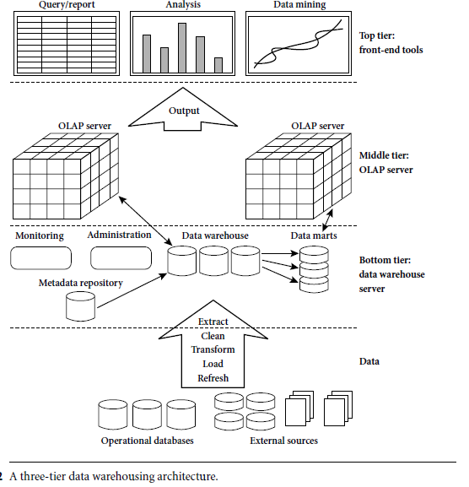
A Three-Tier Data Warehouse Architecture
Data Mining: Concepts and Techniques

Slide 12
Data Warehouse: A Multi-Tiered Architecture
Monitor
&
Integrator
OLAP Server
Other
sources
Metadata
Analysis
Query
Reports
Data mining
Operational
DBs
Extract
Transform
Load
Refresh
Data
Warehouse
Serve
Data Marts
Data Sources
Data Storage
OLAP Engine
Front-End Tools
Data Mining: Concepts and Techniques

Slide 13
Three Data Warehouse Models
Enterprise warehouse
  collects all of the information about subjects spanning the entire organization
Data Mart
  a subset of corporate-wide data that is of value to a specific groups of users. Its scope is confined to specific, selected groups, such as marketing data mart
    Independent vs. dependent (directly from warehouse) data mart
Virtual warehouse
  A set of views over operational databases
  Only some of the possible summary views may be materialized
Data Mining: Concepts and Techniques

Slide 14
Pros and Cons of the top-down and bottom-up approaches to data warehouse development
The top-down approach
Advantages: It serves as a systematic solution and minimizes integration problems.
Disadvantages: It is expensive, takes a long time to develop, and lacks flexibility due to the difficulty in achieving consistency and consensus for a common data model for the entire organization.
Data Mining: Concepts and Techniques

Slide 15
Pros and Cons of the top-down and bottom-up approaches to data warehouse development
The bottom-up approach
Advantages: To the design, development, and deployment of independent data marts provides flexibility, low cost, and rapid return of investment.
Disadvantages: It can lead to problems when integrating various disparate data marts into a consistent enterprise data warehouse.
Data Mining: Concepts and Techniques

Slide 16
Data Warehouse Development: A Recommended Approach
Multi-Tier Data Warehouse
Distributed Data Marts
Enterprise Data Warehouse
Data Mart
Data Mart
Model refinement
Model refinement
Define a high-level corporate data model
Data Mining: Concepts and Techniques

Slide 17
Recommended Method
The development of DW is implemented in an incremental and evolutionary manner.
First, a high-level corporate data model is defined that provides a corporate-wide information.
This high-level model, will be refined in the further development of enterprise data warehouses and data marts.
Second, independent data marts can be implemented in parallel with the enterprise warehouse.
Third, distributed data marts can be constructed to integrate different data marts via hub servers.
Finally, a multitier data warehouse is constructed where the enterprise warehouse is the sole custodian.
Data Mining: Concepts and Techniques

Slide 18
Data Warehouse Back-End Tools and Utilities
Data extraction
  get data from multiple, heterogeneous, and external sources
Data cleaning
  detect errors in the data and rectify them when possible
Data transformation
  convert data from legacy or host format to warehouse format
Load
  sort, summarize, consolidate, compute views, check integrity, and build indicies and partitions
Refresh
  propagate the updates from the data sources to the warehouse
Data Mining: Concepts and Techniques

Slide 19
Metadata Repository
Meta data is the data defining warehouse objects. It stores:
Description of the structure of the data warehouse
  schema, view, dimensions, hierarchies, derived data defn, data mart locations and contents
Operational meta-data
  data lineage (history of migrated data and transformation path), currency of data (active, archived, or purged), monitoring information (warehouse usage statistics, error reports, audit trails)
The algorithms used for summarization
The mapping from operational environment to the data warehouse
Data related to system performance
  warehouse schema, view and derived data definitions
Business data
  business terms and definitions, ownership of data, charging policies
Data Mining: Concepts and Techniques

Slide 20
OLAP Server Architectures: types of OLAP
Relational OLAP (ROLAP)
  Use relational or extended-relational DBMS to store and manage warehouse data and OLAP middle ware
  Include optimization of DBMS backend, implementation of aggregation navigation logic, and additional tools and services
  Greater scalability
Multidimensional OLAP (MOLAP)
  Sparse array-based multidimensional storage engine
  Fast indexing to pre-computed summarized data
Hybrid OLAP (HOLAP) (e.g., Microsoft SQLServer)
  Flexibility, e.g., low level: relational, high-level: array
Specialized SQL servers (e.g., Redbricks)
  Specialized support for SQL queries over star/snowflake schemas
Data Mining: Concepts and Techniques

Slide 21
The Multi-Dimensional Data Model
“Sales by product line over the past six months”
“Sales by store between 1990 and 1995”
Store Info
Key columns joining fact table
to dimension tables
Numerical Measures
Prod Code Time Code Store Code Sales Qty
Fact table for
measures
Product Info
Dimension tables
Time Info
. . .

Slide 22
ROLAP: Dimensional Modeling Using Relational DBMS
Special schema design: star, snowflake
Special indexes: bitmap, multi-table join
Proven technology (relational model, DBMS), tend to outperform specialized MDDB especially on large data sets
Products
  IBM DB2, Oracle, Sybase IQ, RedBrick, Informix

Slide 23
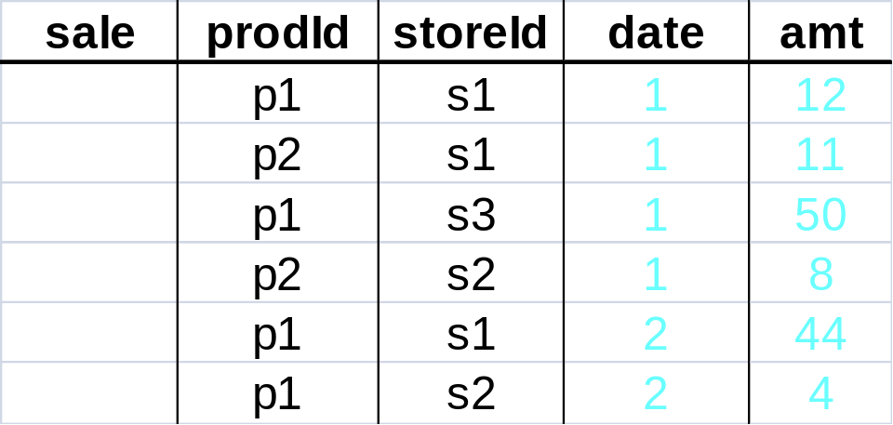
Aggregates
Add up amounts for day 1
In SQL: SELECT sum(amt) FROM SALE
WHERE date = 1
81

Slide 24
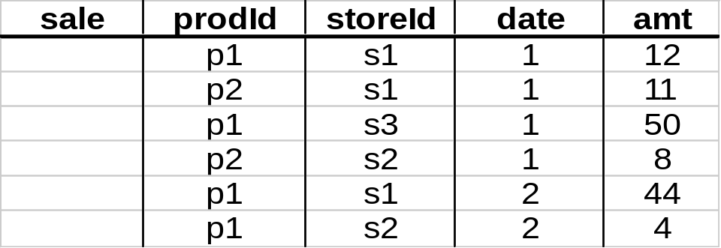
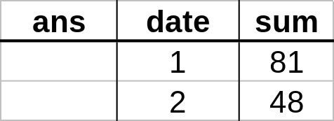
Aggregates
Add up amounts by day
In SQL: SELECT date, sum(amt) FROM SALE
GROUP BY date

Slide 25
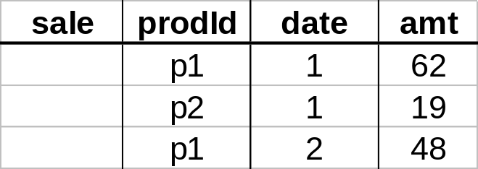
Another Example
Add up amounts by day, product
SQL: SELECT prodid, date, sum(amt) FROM SALE
GROUP BY date, prodId
rollup
drill-down

Slide 26
Points to be noticed about ROLAP
Defines complex, multi-dimensional data with simple model
Reduces the number of joins a query has to process
Allows the data warehouse to evolve with rel. low maintenance
Can contain both detailed and summarized data.
ROLAP is based on familiar, proven, and already selected technologies.
BUT!!!
SQL for multi-dimensional manipulation of calculations.

Slide 27
MOLAP: Dimensional Modeling Using the Multi Dimensional Model
MDDB: a special-purpose data model
Facts stored in multi-dimensional arrays
Dimensions used to index array
Sometimes on top of relational DB
Products
  Pilot, Arbor Essbase, Gentia

Slide 28
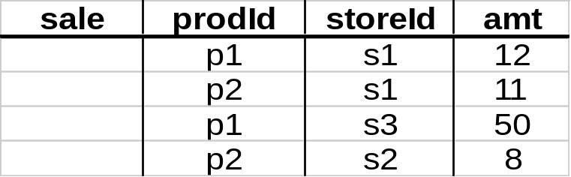
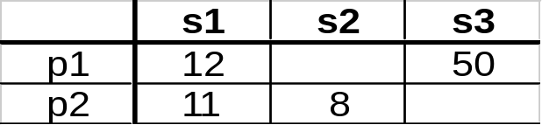
The MOLAP Cube
Fact table view:
Multi-dimensional cube:
dimensions = 2

Slide 29
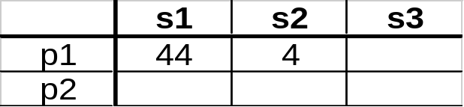
3-D Cube
Fact table view:
Multi-dimensional cube:
day 2
day 1
dimensions = 3

Slide 30
Example
roll-up to region
Dimensions:
Time, Product, Store
Attributes:
Product (upc, price, …)
Store …
…
Hierarchies:
Product → Brand → …
Day → Week → Quarter
Store → Region → Country
NY
Store
SF
roll-up to brand
LA
Juice
Milk
Coke
Cream
Soap
Bread
10
34
56
32
12
56
Product
roll-up to week
M T W Th F S S
Time
56 units of bread sold in LA on M

Slide 31
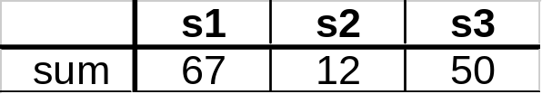
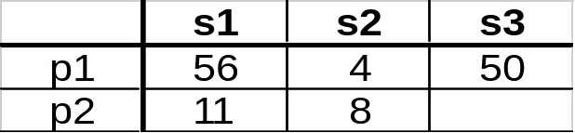
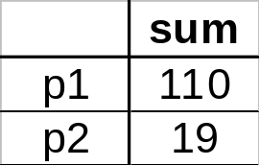
Cube Aggregation: Roll-up
Example: computing sums
day 2
. . .
day 1
129
rollup
drill-down

Slide 32
Cube Operators for Roll-up
day 2
. . .
day 1
sale(s1,*,*)
129
sale(s2,p2,*)
sale(*,*,*)

Slide 33
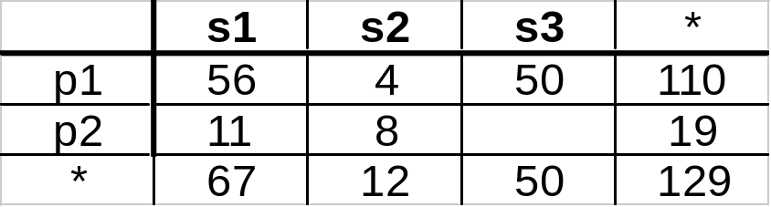
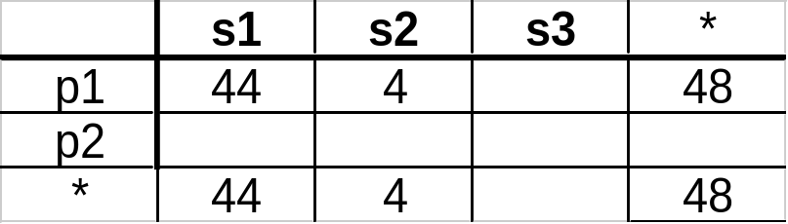
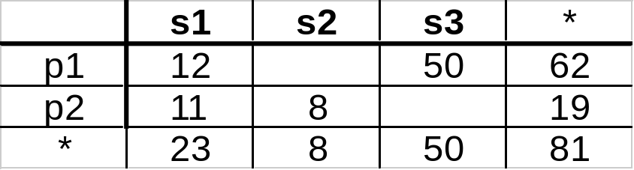
Extended Cube
*
day 2
sale(*,p2,*)
day 1

Slide 34
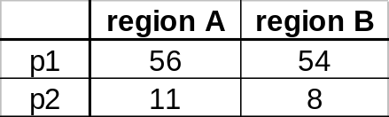
Aggregation Using Hierarchies
day 2
store
day 1
region
country
(store s1 in Region A;
stores s2, s3 in Region B)

Slide 35
Points to be noticed about MOLAP
Pre-calculating or pre-consolidating transactional data improves speed.
BUT
Fully pre-consolidating incoming data, MDDs require an enormous amount of overhead both in processing time and in storage. An input file of 200MB can easily expand to 5GB
MDDs are great candidates for the <50GB department data marts.
Rolling up and Drilling down through aggregate data.
With MDDs, application design is essentially the definition of dimensions and calculation rules, while the RDBMS requires that the database schema be a star or snowflake.

Slide 36
Hybrid OLAP (HOLAP)
HOLAP = Hybrid OLAP:
  Best of both worlds
  Storing detailed data in RDBMS
  Storing aggregated data in MDBMS
  User access via MOLAP tools

Slide 37
Data Flow in HOLAP
RDBMS Server
MDBMS Server
Client
Multi-dimensional access
SQL-Read
Multidimensional Viewer
User
data
Multi-
dimensionaldata
Meta data
Derived
data
SQL-Reach Through
Relational
Viewer
SQL-Read

Slide 38
When deciding which technology to go for, consider:
1) Performance:
    How fast will the system appear to the end-user?
    MDD server vendors believe this is a key point in their favor.
  2) Data volume and scalability:
    While MDD servers can handle up to 50GB of storage, RDBMS servers can handle hundreds of gigabytes and terabytes.

Slide 39
An experiment with Relational and the Multidimensional models on a data set
The analysis of the author’s example illustrates the following differences between the best Relational alternative and the Multidimensional approach.
* This may include the calculation of many other derived data without any additional I/O.
Reference: http://dimlab.usc.edu/csci599/Fall2002/paper/I2_P064.pdf
 | relational | Multi-dimensional | Improvement
Disk space requirement (Gigabytes) | 17 | 10 | 1.7
Retrieve the corporate measures Actual Vs Budget, by month (I/O’s) | 240 | 1 | 240
Calculation of Variance Budget/Actual for the whole database (I/O time in hours) | 237 | 2* | 110*

